Slide 1
CS162 Operating Systems and Systems Programming Lecture 3 Processes (con’t), System Calls, Fork,
January 24th, 2023
Prof. John Kubiatowicz
http://cs162.eecs.Berkeley.edu

Slide 2
Recall: Four Fundamental OS Concepts
Thread: Execution Context
Fully describes program state
Program Counter, Registers, Execution Flags, Stack
Address space (with or w/o translation)
Set of memory addresses accessible to program (for read or write)
May be distinct from memory space of the physical machine (in which case programs operate in a virtual address space)
Process: an instance of a running program
Protected Address Space + One or more Threads
Dual mode operation / Protection
Only the “system” has the ability to access certain resources
Combined with translation, isolates programs from each other and the OS from programs

Slide 3

Recall: OS Bottom Line: Run Programs
0xFFF…
Executable
Program Source
OS
int main()
{ … ;
}
compiler
data
Load & Execute
stack
editor
Memory
instructions
heap
a.out
data
foo.c
Create OS “PCB”, address space, stack and heap
Load instruction and data segments of executable file into memory
“Transfer control to program”
Provide services to program
While protecting OS and program
instructions
0x000…
PC:
registers
Processor

Slide 4
Recall: Protected Address Space
Program operates in an address space that is distinct from the physical memory space of the machine
“physical address”
0x000…
“virtual address”
Processor
translator
Memory
Registers
Page Table
<Frame Addr>
0xFFF…

Slide 5
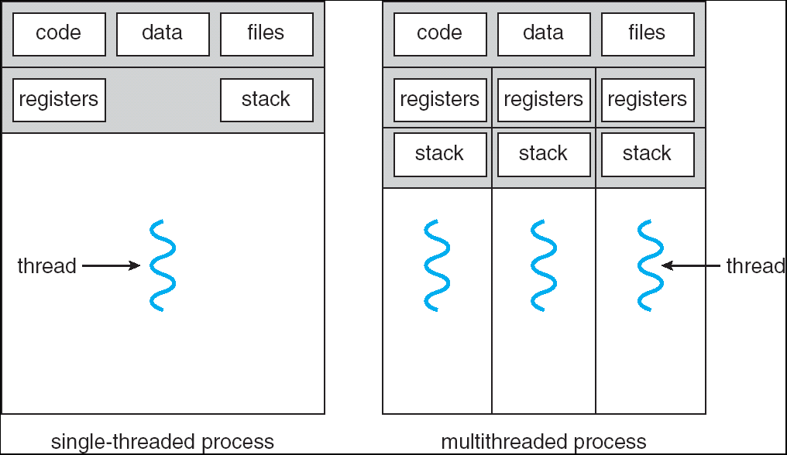
Recall: Single and Multithreaded Processes
Threads encapsulate concurrency: “Active” component
Address spaces encapsulate protection: “Passive” part
Keeps buggy program from trashing the system
Why have multiple threads per address space?
Notes:
Sometimes need parallelism for a single job, and processes are very expensive – to start, switch between, and to communicate between

Slide 6
Recall: Simple address translation with Base and Bound
0000…
code
0000…
code
Static Data
heap
Addresses translated on-the-fly
Static Data
heap
stack
0100…
stack
Base Address
1000…
code
1000…
0010…
Program
address
0010…
Static Data
1010…
heap
Bound
<
stack
1100…
0100…
Can the program touch OS?
Can it touch other programs?
FFFF…

Slide 7
Simple B&B: User => Kernel
0000…
Proc 1
Proc 2
Proc n
code
…
Static Data
OS
heap
stack
sysmode
0
1000…
code
Base
1000 …
0000…
Static Data
Bound
0100…
FFFF…
heap
uPC
xxxx…
stack
1100…
PC
0000 1234
code
3000…
regs
00FF…
Static Data
How to return to system?
…
heap
stack
3080…
FFFF…

Slide 8
Simple B&B: Interrupt
0000…
Proc 1
Proc 2
Proc n
code
…
Static Data
OS
heap
stack
sysmode
1
1000…
code
Base
1000 …
0000…
Static Data
Bound
0100 …
FFFF…
heap
uPC
0000 1234
stack
1100…
PC
IntrpVector[i]
code
3000…
regs
00FF…
Static Data
How to save registers and set up system stack?
…
heap
stack
3080…
FFFF…

Slide 9
Simple B&B: Switch User Process
0000…
Proc 1
Proc 2
Proc n
code
RTU
…
Static Data
OS
heap
stack
sysmode
1
1000…
1000 …
code
Base
3000 …
0000…
Static Data
0100 …
Bound
0080 …
FFFF…
heap
0000 1234
uPC
0000 0248
regs
stack
1100…
PC
0001 0124
00FF…
code
3000…
regs
00D0…
Static Data
How to save registers and set up system stack?
…
heap
stack
3080…
FFFF…

Slide 10
Simple B&B: “resume”
0000…
Proc 1
Proc 2
Proc n
code
RTU
…
Static Data
OS
heap
stack
sysmode
0
1000…
1000 …
code
Base
3000 …
0000…
Static Data
0100 …
Bound
0080 …
FFFF…
heap
0000 1234
uPC
xxxx xxxx
regs
stack
1100…
PC
000 0248
00FF…
code
3000…
regs
00D0…
Static Data
How to save registers and set up system stack?
…
heap
stack
3080…
FFFF…

Slide 11
Running Many Programs
We have the basic mechanism to
switch between user processes and the kernel,
the kernel can switch among user processes,
Protect OS from user processes and processes from each other
Questions ???
How do we represent user processes in the OS?
How do we decide which user process to run?
How do we pack up the process and set it aside?
How do we get a stack and heap for the kernel?
Aren’t we wasting are lot of memory?

Slide 12
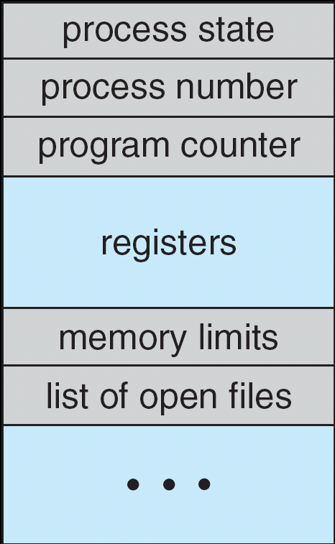
Multiplexing Processes: The Process Control Block
Kernel represents each process as a process control block (PCB)
Status (running, ready, blocked, …)
Register state (when not ready)
Process ID (PID), User, Executable, Priority, …
Execution time, …
Memory space, translation, …
Kernel Scheduler maintains a data structure containing the PCBs
Give out CPU to different processes
This is a Policy Decision
Give out non-CPU resources
Memory/IO
Another policy decision
Process Control
Block

Slide 13
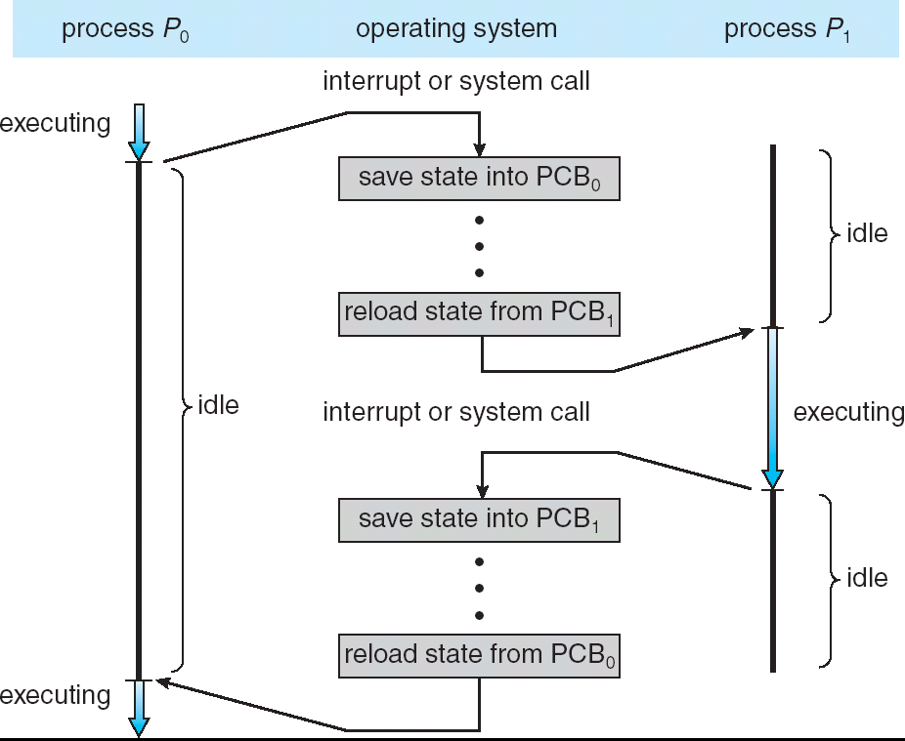
CPU Switch From Process A to Process B
User Mode
Kernel/System Mode
User Mode

Slide 14
Scheduler
if ( readyProcesses(PCBs) ) {
nextPCB = selectProcess(PCBs);
run( nextPCB );
} else {
run_idle_process();
}
Scheduling: Mechanism for deciding which processes/threads receive the CPU
Lots of different scheduling policies provide …
Fairness or
Realtime guarantees or
Latency optimization or ..

Slide 15
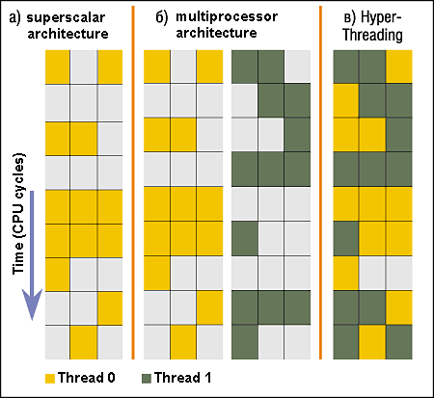
Simultaneous MultiThreading/Hyperthreading
Hardware scheduling technique
Superscalar processors can execute multiple instructions that are independent.
Hyperthreading duplicates register state to make a second “thread,” allowing more instructions to run.
Can schedule each thread as if were separate CPU
But, sub-linear speedup!
Original technique called “Simultaneous Multithreading”
http://www.cs.washington.edu/research/smt/index.html
SPARC, Pentium 4/Xeon (“Hyperthreading”), Power 5
Colored blocks show
instructions executed
Notes:
Intel seems to be discarding SMT in Silvermont because of power problems

Slide 16
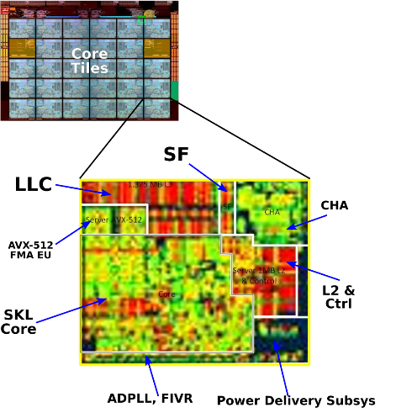
Also recall: The World Is Parallel: Intel SkyLake (2017)
Up to 28 Cores, 56 Threads
694 mm² die size (estimated)
Many different instructions
Security, Graphics
Caches on chip:
L2: 28 MiB
Shared L3: 38.5 MiB (non-inclusive)
Directory-based cache coherence
Network:
On-chip Mesh Interconnect
Fast off-chip network directlry supports 8-chips connected
DRAM/chips
Up to 1.5 TiB
DDR4 memory

Slide 17
Is Base and Bound a Good-Enough Protection Mechanism?
NO: Too simplistic for real systems
Inflexible/Wasteful:
Must dedicate physical memory for potential future use
(Think stack and heap!)
Fragmentation:
Kernel has to somehow fit whole processes into contiguous block of memory
After a while, memory becomes fragmented!
Sharing:
Very hard to share any data between Processes or between Process and Kernel
Need to communicate indirectly through the kernel…

Slide 18
Better: x86 – segments and stacks
code
Static Data
Processor Registers
heap
CS
EIP
stack
SS
ESP
CS:
EIP:
code
EAX
DS
EBX
ES
ECX
Static Data
EDX
ESI
EDI
heap
Start address, length and access rights associated with each segment
SS:
ESP:
stack

Slide 19
Better Alternative: Address Mapping
Code
Data
Heap
Stack
Data 2
Code
Data
Heap
Stack
Stack 1
Heap 1
Code 1
Stack 2
Prog 1
Virtual
Address
Space 1
Data 1
Prog 2
Virtual
Address
Space 2
Heap 2
Code 2
OS code
Translation Map 1
OS data
Translation Map 2
OS heap &
Stacks
Physical Address Space

Slide 20
Administrivia: Getting started!
Kubiatowicz Office Hours:
Monday/Wednesday 2-3pm, in 673 Soda Hall
Homework 0: Due Tomorrow!
Get familiar with the cs162 tools
configure your VM, submit via git
Practice finding out information:
How to use GDB? How to understand output of unix tools?
We don’t assume that you already know everything!
Learn to use “man” (command line), “help” (in gdb, etc), google
Project 0: Started Yesterday!
Learn about Pintos and how to modify and debug kernel
Important for getting started on projects!
Should be going to sections now – Important information there
Any section will do until groups assigned

Slide 21
Administrivia (Con’t)
THIS Friday is Drop Deadline! HARD TO DROP LATER!
If you know you are going to drop, do so now to leave room for others on waitlist!
Why do we do this? So that groups aren’t left without members!
Group sign up via autograder form next week
Get finding groups of 4 people ASAP
Priority for same section; if cannot make this work, keep same TA
Remember: Your TA needs to see you in section!
Midterm 1: 2/17
7-9PM in person
We will say more about material when we get closer…
Midterm 1 conflicts
We will handle these conflicts after have final class roster
Watch for queries by HeadTA to collect information

Slide 22
Recall: 3 types of Kernel Mode Transfer
Syscall
Process requests a system service, e.g., exit
Like a function call, but “outside” the process
Does not have the address of the system function to call
Like a Remote Procedure Call (RPC) – for later
Marshall the syscall id and args in registers and exec syscall
Interrupt
External asynchronous event triggers context switch
eg. Timer, I/O device
Independent of user process
Trap or Exception
Internal synchronous event in process triggers context switch
e.g., Protection violation (segmentation fault), Divide by zero, …

Slide 23
Recall: User/Kernel (Privileged) Mode
User Mode
interrupt
exception
syscall
rtn
rfi
Kernel Mode
exit
exec
Limited HW access
Full HW access

Slide 24
Implementing Safe Kernel Mode Transfers
Important aspects:
Controlled transfer into kernel (e.g., syscall table)
Separate kernel stack!
Carefully constructed kernel code packs up the user process state and sets it aside
Details depend on the machine architecture
More on this next time
Should be impossible for buggy or malicious user program to cause the kernel to corrupt itself!

Slide 25
Hardware support: Interrupt Control
Interrupt processing not visible to the user process:
Occurs between instructions, restarted transparently
No change to process state
What can be observed even with perfect interrupt processing?
Interrupt Handler invoked with interrupts ‘disabled’
Re-enabled upon completion
Non-blocking (run to completion, no waits)
Pack up in a queue and pass off to an OS thread for hard work
wake up an existing OS thread

Slide 26
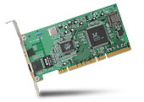
Interrupt Controller
Interrupt Mask
Priority Encoder
IntID
CPU
Interrupt
Int Disable
Timer
Software
Interrupt
Control
NMI
Network
Interrupts invoked with interrupt lines from devices
Interrupt controller chooses interrupt request to honor
Interrupt identity specified with ID line
Mask enables/disables interrupts
Priority encoder picks highest enabled interrupt
Software Interrupt Set/Cleared by Software
CPU can disable all interrupts with internal flag
Non-Maskable Interrupt line (NMI) can’t be disabled

Slide 27
Interrupt Vector
Address and properties of each interrupt handler
interrupt number (i)
intrpHandler_i () {
….
}
Where else do you see this dispatch pattern?
System Call
Exceptions

Slide 28
How do we take interrupts safely?
Interrupt vector
Limited number of entry points into kernel
Kernel interrupt stack
Handler works regardless of state of user code
Interrupt masking
Handler is non-blocking
Atomic transfer of control
“Single instruction”-like to change:
Program counter
Stack pointer
Memory protection
Kernel/user mode
Transparent restartable execution
User program does not know interrupt occurred

Slide 29
Need for Separate Kernel Stacks
Kernel needs space to work
Cannot put anything on the user stack (Why?)
Two-stack model
OS thread has interrupt stack (located in kernel memory) plus User stack (located in user memory)
Syscall handler copies user args to kernel space before invoking specific function (e.g., open)
Interrupts (???)

Slide 30
Before

Slide 31
During Interrupt/System Call

Slide 32
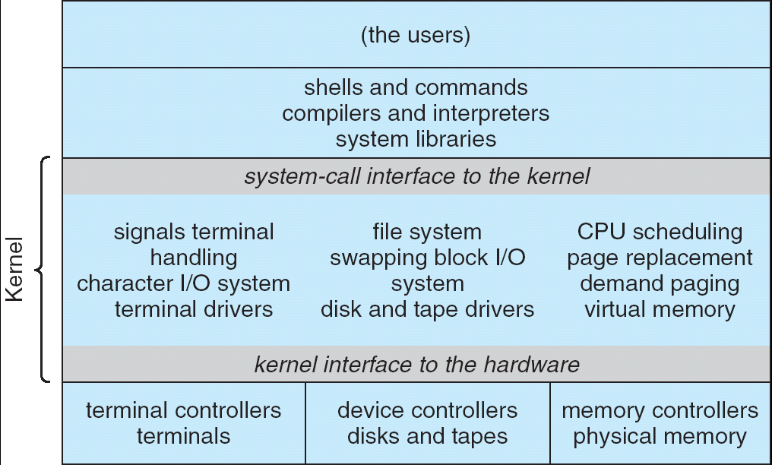
Recall: UNIX System Structure
Applications
User Mode
Standard Libs
Kernel Mode
Hardware

Slide 33
A Narrow Waist
Word Processing
Compilers
Web Browsers
Email
Databases
Web Servers
Application / Service
Portable OS Library
OS
User Mode
System Call
Interface
System Mode
Portable OS Kernel
Software
Platform support, Device Drivers
Hardware
x86
PowerPC
ARM
PCI
Ethernet (1Gbs/10Gbs)
802.11 a/g/n/ac/ax
SCSI
Graphics
Thunderbolt

Slide 34
Kernel System Call Handler
Vector through well-defined syscall entry points!
Table mapping system call number to handler
Locate arguments
In registers or on user (!) stack
Copy arguments
From user memory into kernel memory
Protect kernel from malicious code evading checks
Validate arguments
Protect kernel from errors in user code
Copy results back
Into user memory

Slide 35
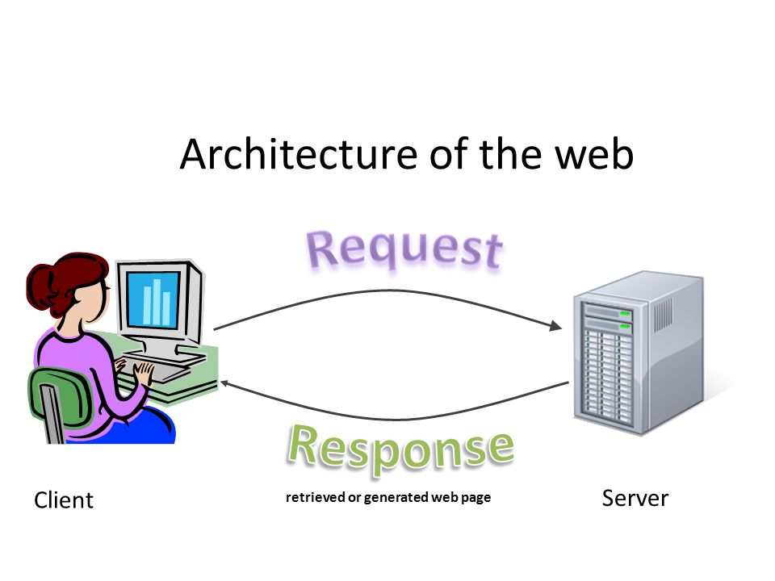
Putting it together: web server
Request
Reply
(retrieved by web server)
Client
Web Server

Slide 36
Putting it together: web server
Server Process
4. parse request
9. format reply
request
buffer
reply
buffer
network
socket
read()
3. kernel
copy
10. network
socket
write()
5. file
read()
8. kernel
copy
Kernel
syscall
RTU
syscall
syscall
RTU
wait
wait
11. kernel copy
from user buffer
to network buffer
2. copy arriving
packet (DMA)
interrupt
interrupt
12. format outgoing
packet and DMA
6. disk
request
7. disk data
(DMA)
Hardware
Network
interface
Disk interface
Request
Reply

Slide 37
Recall: Processes
How to manage process state?
How to create a process?
How to exit from a process?
Remember: Everything outside of the kernel is running in a process!
Including the shell! (Homework 2)
Processes are created and managed… by processes!

Slide 38
Bootstrapping
If processes are created by other processes, how does the first process start?
First process is started by the kernel
Often configured as an argument to the kernel before the kernel boots
Often called the “init” process
After this, all processes on the system are created by other processes

Slide 39
Process Management API
exit – terminate a process
fork – copy the current process
exec – change the program being run by the current process
wait – wait for a process to finish
kill – send a signal (interrupt-like notification) to another process
sigaction – set handlers for signals

Slide 40
Process Management API
exit – terminate a process
fork – copy the current process
exec – change the program being run by the current process
wait – wait for a process to finish
kill – send a signal (interrupt-like notification) to another process
sigaction – set handlers for signals

Slide 41
pid.c
#include <stdlib.h>
#include <stdio.h>
#include <string.h>
#include <unistd.h>
#include <sys/types.h>
int main(int argc, char *argv[])
{
/* get current processes PID */
pid_t pid = getpid();
printf("My pid: %d\n", pid);
exit(0);
}
Q: What if we let main return without ever calling exit?
The OS Library calls exit() for us!
The entrypoint of the executable is in the OS library
OS library calls main
If main returns, OS library calls exit
You’ll see this in Project 0: init.c

Slide 42
Process Management API
exit – terminate a process
fork – copy the current process
exec – change the program being run by the current process
wait – wait for a process to finish
kill – send a signal (interrupt-like notification) to another process
sigaction – set handlers for signals

Slide 43
Creating Processes
pid_t fork() – copy the current process
New process has different pid
New process contains a single thread
Return value from fork(): pid (like an integer)
When > 0:
Running in (original) Parent process
return value is pid of new child
When = 0:
Running in new Child process
When < 0:
Error! Must handle somehow
Running in original process
State of original process duplicated in both Parent and Child!
Address Space (Memory), File Descriptors (covered later), etc…

Slide 44
fork1.c
#include <stdlib.h>
#include <stdio.h>
#include <unistd.h>
#include <sys/types.h>
int main(int argc, char *argv[]) {
pid_t cpid, mypid;
pid_t pid = getpid(); /* get current processes PID */
printf("Parent pid: %d\n", pid);
cpid = fork();
if (cpid > 0) { /* Parent Process */
mypid = getpid();
printf("[%d] parent of [%d]\n", mypid, cpid);
} else if (cpid == 0) { /* Child Process */
mypid = getpid();
printf("[%d] child\n", mypid);
} else {
perror("Fork failed");
}
}

Slide 45
fork1.c
#include <stdlib.h>
#include <stdio.h>
#include <unistd.h>
#include <sys/types.h>
int main(int argc, char *argv[]) {
pid_t cpid, mypid;
pid_t pid = getpid(); /* get current processes PID */
printf("Parent pid: %d\n", pid);
cpid = fork();
if (cpid > 0) { /* Parent Process */
mypid = getpid();
printf("[%d] parent of [%d]\n", mypid, cpid);
} else if (cpid == 0) { /* Child Process */
mypid = getpid();
printf("[%d] child\n", mypid);
} else {
perror("Fork failed");
}
}
c
p

Slide 46
fork1.c
#include <stdlib.h>
#include <stdio.h>
#include <unistd.h>
#include <sys/types.h>
int main(int argc, char *argv[]) {
pid_t cpid, mypid;
pid_t pid = getpid(); /* get current processes PID */
printf("Parent pid: %d\n", pid);
cpid = fork();
if (cpid > 0) { /* Parent Process */
mypid = getpid();
printf("[%d] parent of [%d]\n", mypid, cpid);
} else if (cpid == 0) { /* Child Process */
mypid = getpid();
printf("[%d] child\n", mypid);
} else {
perror("Fork failed");
}
}
p
c

Slide 47
fork_race.c
int i;
pid_t cpid = fork();
if (cpid > 0) {
for (i = 0; i < 10; i++) {
printf("Parent: %d\n", i);
// sleep(1);
}
} else if (cpid == 0) {
for (i = 0; i > -10; i--) {
printf("Child: %d\n", i);
// sleep(1);
}
}
What does this print?
Would adding the calls to sleep() matter?
Recall: a process consists of one or more threads executing in an address space
Here, each process has a single thread
These threads execute concurrently

Slide 48
Running Another Program
With threads, we could call pthread_create to create a new thread executing a separate function
With processes, the equivalent would be spawning a new process executing a different program
How can we do this?

Slide 49
Process Management API
exit – terminate a process
fork – copy the current process
exec – change the program being run by the current process
wait – wait for a process to finish
kill – send a signal (interrupt-like notification) to another process
sigaction – set handlers for signals

Slide 50
fork3.c
…
cpid = fork();
if (cpid > 0) { /* Parent Process */
tcpid = wait(&status);
} else if (cpid == 0) { /* Child Process */
char *args[] = {“ls”, “-l”, NULL};
execv(“/bin/ls”, args);
/* execv doesn’t return when it works.
So, if we got here, it failed! */
perror(“execv”);
exit(1);
}
…

Slide 51
Process Management
child
pid=fork();
if (pid==0)
exec(…);
else
wait(&stat)
main() {
…
}
exec
fork
pid=fork();
if (pid==0)
exec(…);
else
wait(&stat)
parent
pid=fork();
if (pid==0)
exec(…);
else
wait(&stat)
fork
wait

Slide 52
Process Management API
exit – terminate a process
fork – copy the current process
exec – change the program being run by the current process
wait – wait for a process to finish
kill – send a signal (interrupt-like notification) to another process
sigaction – set handlers for signals

Slide 53
fork2.c – parent waits for child to finish
int status;
pid_t tcpid;
…
cpid = fork();
if (cpid > 0) { /* Parent Process */
mypid = getpid();
printf("[%d] parent of [%d]\n", mypid, cpid);
tcpid = wait(&status);
printf("[%d] bye %d(%d)\n", mypid, tcpid, status);
} else if (cpid == 0) { /* Child Process */
mypid = getpid();
printf("[%d] child\n", mypid);
exit(42);
}
…

Slide 54
Process Management API
exit – terminate a process
fork – copy the current process
exec – change the program being run by the current process
wait – wait for a process to finish
kill – send a signal (interrupt-like notification) to another process
sigaction – set handlers for signals

Slide 55
inf_loop.c
#include <stdlib.h>
#include <stdio.h>
#include <sys/types.h>
#include <unistd.h>
#include <signal.h>
void signal_callback_handler(int signum) {
printf(“Caught signal!\n”);
exit(1);
}
int main() {
struct sigaction sa;
sa.sa_flags = 0;
sigemptyset(&sa.sa_mask);
sa.sa_handler = signal_callback_handler;
sigaction(SIGINT, &sa, NULL);
while (1) {}
}
Q: What would happen if the process receives a SIGINT signal, but does not register a signal handler?
A: The process dies!
For each signal, there is a default handler defined by the system

Slide 56
Common POSIX Signals
SIGINT – control-C
SIGTERM – default for kill shell command
SIGSTP – control-Z (default action: stop process)
SIGKILL, SIGSTOP – terminate/stop process
Can’t be changed with sigaction
Why?

Slide 57
Shell
A shell is a job control system
Allows programmer to create and manage a set of programs to do some task
You will build your own shell in Homework 2…
… using fork and exec system calls to create new processes…
… and the File I/O system calls we’ll see next time to link them together

Slide 58
Process vs. Thread APIs
Why have fork() and exec() system calls for processes, but just a pthread_create() function for threads?
Convenient to fork without exec: put code for parent and child in one executable instead of multiple
It will allow us to programmatically control child process’ state
By executing code before calling exec() in the child
We’ll see this in the case of File I/O next time
Windows uses CreateProcess() instead of fork()
Also works, but a more complicated interface

Slide 59
Threads vs. Processes
If we have two tasks to run concurrently, do we run them in separate threads, or do we run them in separate processes?
Depends on how much isolation we want
Threads are lighter weight [why?]
Processes are more strongly isolated

Slide 60
Conclusion
Process: execution environment with Restricted Rights
Address Space with One or More Threads
Owns memory (address space)
Owns file descriptors, file system context, …
Encapsulate one or more threads sharing process resources
Interrupts
Hardware mechanism for regaining control from user
Notification that events have occurred
User-level equivalent: Signals
Native control of Process
Fork, Exec, Wait, Signal

